Slide 1




COMCAST CUSTOMER SOLUTIONS
Creator: Shanika Udayangani

Slide 2


Coming up NEXT!
Comcast customer complaints and solutions to mitigate the barriers of our customers
Dataset: https://www.kaggle.com/datasets/yasserh/comcast-telecom-complaints

Slide 3
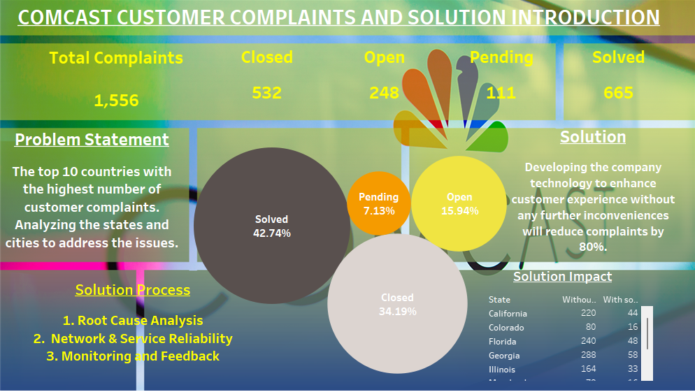

Slide 4

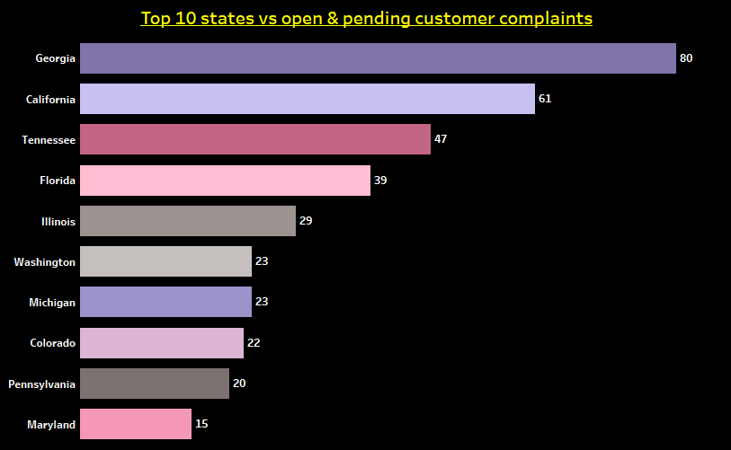
Open & Pending
359 open
& pending cases in
all these 10 states.

Slide 5
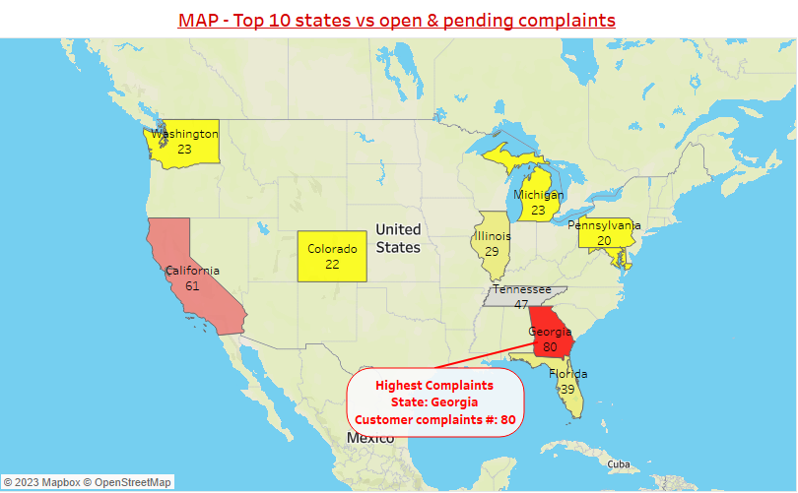
Complaint locations?
The highest complaints were from Georgia while the lowest was from Maryland.

Slide 6
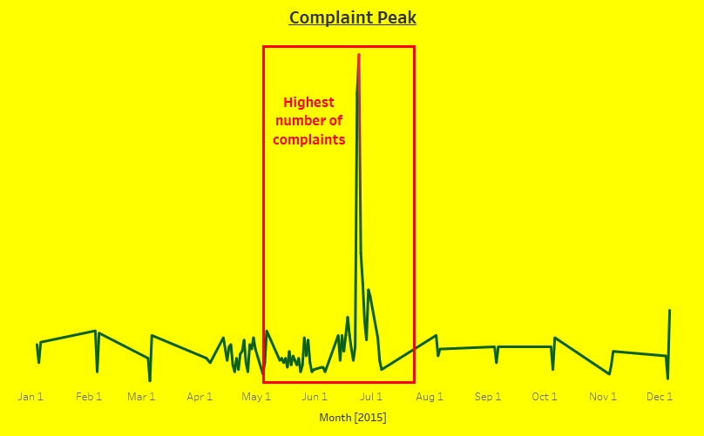
Complaint peak seasons?
Reasons?
Summer season,
Higher communications,
Fewer staff working due to summer break
The highest reported between May to July.

Slide 7
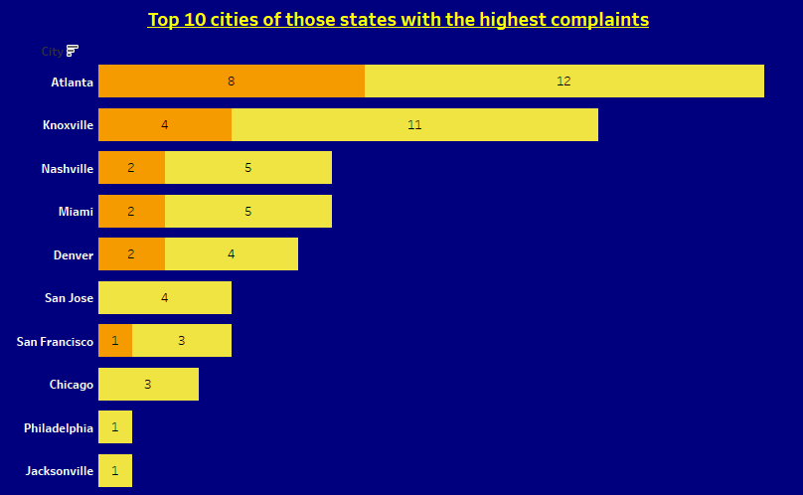

The exact cities?
The highest number of open & pending complaints are from Atlanta & Knoxville.

Slide 8

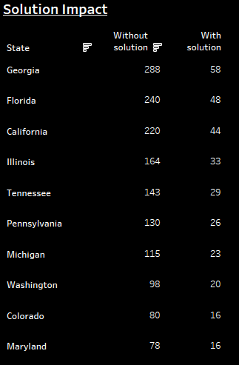
Summary
Introducing;
Root Cause Analysis
Network & Service Reliability
Monitoring and Feedback

Slide 9





Thank You!
Virtual communication is the future
Comcast is a leader in virtual communication
Comcast helps businesses communicate effectively
Comcast is
easy to use

